Slide 1
CX3-11project week 8
Todo List Using Android Studio
Bill Proudfoot

Slide 2
Project Brief
MVP
You are required to write an android app which will allow the user to maintain a task list. The user should be able to enter tasks and display them in a list. The list should only show the bare details of each task. Selecting a task from the list should bring up another screen which shows full details of the task. Users should also be able to mark tasks as completed.
Project Extensions
Allow the user to prioritise and/or categorise tasks
Use the calendar to set due dates on tasks.

Slide 3
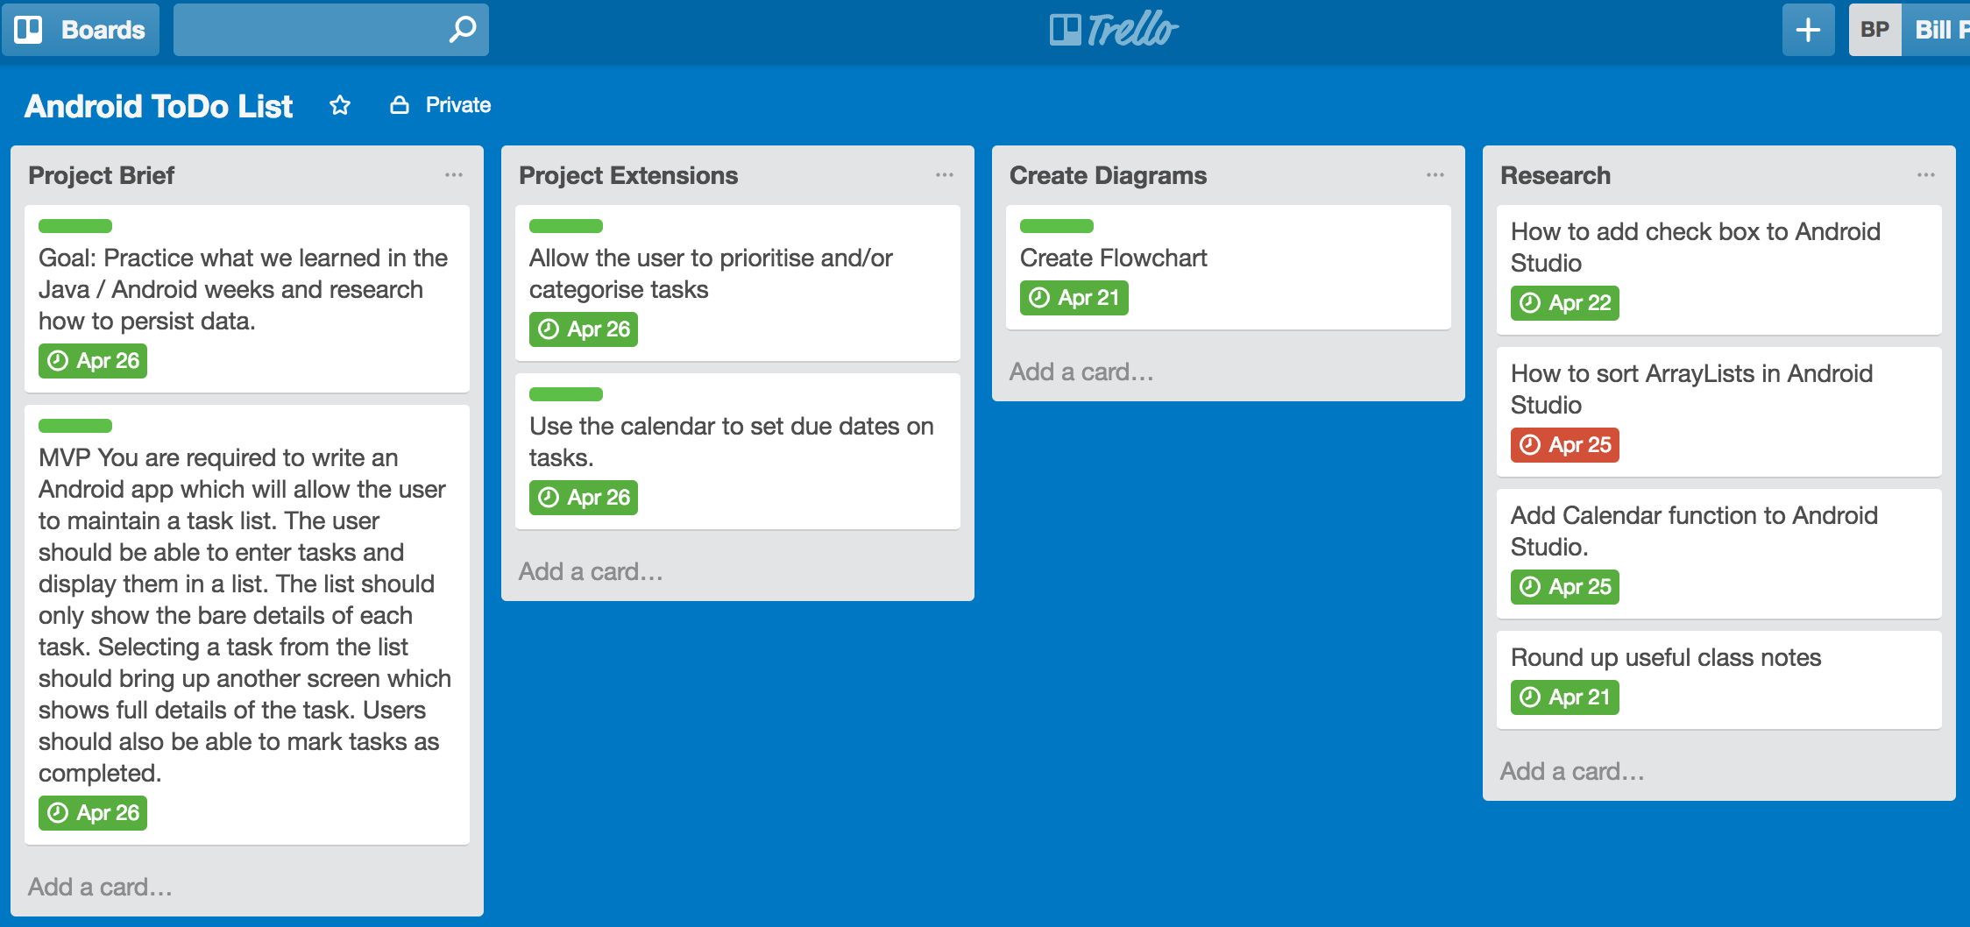
Planning

Slide 7
What I didn’t manage to finish that I had hoped to
Items not complete as thought of in design concept
Welcome page then onto app.
Navigation in menu button – overlooked created early on, always intend on coming back to.
Status switch “green for done” rather than “red for on”.
Group radio buttons as a bank of 3 x 2; currently 1 x 6.
Additional styling and backgrounds ( gradient ) etc.

Slide 8
Favorite Code
radioGroup = (RadioGroup) findViewById(R.id.radio_group); radioGroup.setOnCheckedChangeListener(new RadioGroup.OnCheckedChangeListener() { @Override public void onCheckedChanged(RadioGroup group, @IdRes int checkedId) { checked = radioGroup.indexOfChild(findViewById(checkedId)); switch (checked) { case 0: Toast.makeText(DetailsActivity.this, "DIY Category has been selected", Toast.LENGTH_LONG).show(); break; case 1: Toast.makeText(DetailsActivity.this, "Chore Category has been selected", Toast.LENGTH_LONG).show(); break; case 2: Toast.makeText(DetailsActivity.this, "Shopping Category has been selected", Toast.LENGTH_LONG).show(); break; case 3: Toast.makeText(DetailsActivity.this, "Exercise Category has been selected", Toast.LENGTH_LONG).show(); break; case 4: Toast.makeText(DetailsActivity.this, "Work Category has been selected", Toast.LENGTH_LONG).show(); break; case 5: Toast.makeText(DetailsActivity.this, "Other Category is selected", Toast.LENGTH_LONG).show(); break; default: break; } } });

Slide 9
Main aspects learnt.
At each stage refer back to your plan and the mvp and extensions make sure you don’t stray into extensions until mvp met.
Practiced what we learned in the Java / Android weeks and researched how to persist data.
Use of checkbox, radio buttons and calendar date-picker functions android studio.
Consider perceived solution and check all it can do before starting coding.
I had started using check boxes for category but wanted the ability to select only one. Although possible with checkboxes additional code is messy. Found you can group radio buttons as a better solution after I had set up all checkboxes and their toasts and onclicklistener actions.
Also savedtextpreference and Json. I.e. individual element items (task, detail, date etc.) versus string for whole task.
Styling can be a timedrain. Draw it and research how to achieve might be better more effective and efficient than play and see, but maybe not as much fun/frustration.

Slide 10
Further Extensions
Add time management options.
Add estimated time for each task.
Calculate task times on a given date.
assign priority/planned order of execution/completion.
Order listview’s by priority/planned order of execution.
Capture done date and actual time taken.

Slide 11
Demo

Slide 12
Thank you
Any questions ?

